Slide 1









Strategy Session
with Dr Sandeep Goyal

Slide 2
On the Agenda
What we discovered about you
Basis our questionnaire
Your current portfolio
The goods, the gaps and the opportunities
Our tailored strategy for you
Focussed on your goals and risk profile
Financial Planning
To ensure all your goals are met on time
Welcome Back,
Dr Sandeep
What next?
Portfolio transition and execution
Numbers as of 17 Feb 2026

Slide 3

You at a glance
Your Goal
Retirement Planning
Risk Profile
Very Aggressive
Investment Horizon
8+ Years
Investment with Infinite
Very Aggressive Investor
INR 1 Cr with INR 25K monthly SIP*
We categorize Risk profiles as Very Aggressive, Aggressive, Balanced, Conservative, Very Conservative
Questionnaire with answer here
Current Age: 48
SIP Step-Up every year: 10%
Notes:
Current Age - 48

Slide 4
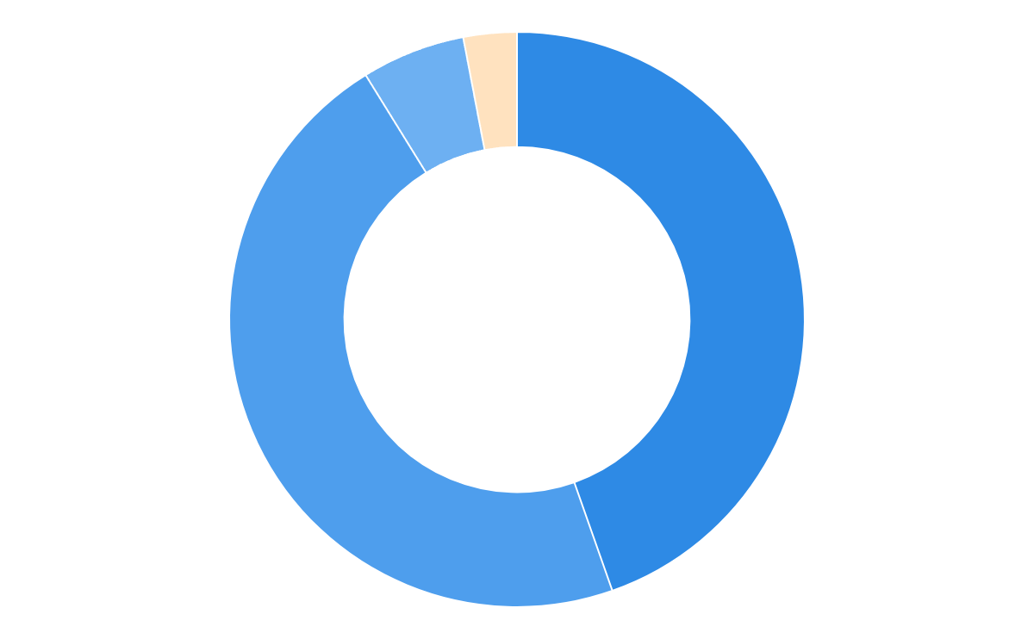
Your current portfolio snapshot
Current Value
Invested Amount
₹94.9L
₹53L
Equity
97%
Current XIRR
Benchmark XIRR
Aggressive
45%
17.6%
19.1%
Portfolio
Allocation
Balanced
47%
Conservative
5%
Hybrid
3%
Your Portfolio Risk
Aggressive
Small + Mid Allocation: 45%
Doesn’t match your risk profile
SOA
Demat
96%
4%
Benchmark is weighted average benchmark
Portfolio gains: ₹41.8L
Benchmark gains: ₹48.3L
For detailed portfolio view, see here

Slide 5
01
What’s working well

Slide 6
What’s working well
The solid foundations already in place
01
02
Consistent investing discipline
Solid Absolute Gains
SIPs & lump sum over 9 years building a corpus of 94.9L
Solid absolute gains of 41.8L on total investment till date
Portfolios are classified as Very Aggressive, Aggressive, Balanced, Conservative, or Very Conservative based on a combination of risk tolerance, investment horizon, and asset allocation

Slide 7
02
What could be better

Slide 8
What could be better
Gaps we can help you fix
01
02
03
Concentration Risk - Scheme Level
Fund
Quality
Higher costs than necessary
2/16 schemes hold 41% of your portfolio. Sundaram Mid Cap & SBI Flexi Cap. On the contrary, 5/16 schemes hold <3%
25% of portfolio is in Off-track / Out of form schemes (2/16), resulting in 12.94L worth of missed gains - SBI Flexi Cap & Aditya BSL Focused
41% exposure to regular plans in equity schemes, you’ve paid
commissions amounting ₹2.8L, and will end up paying 8.04L over next 10 years
#Current distribution of funds across categories is misaligned with your risk tolerance and investment horizon
*Sub-categories are just the different scheme types you’ve invested in for example Flexi Cap, Large Cap, ELSS, Aggressive Hybrid, Sector (Technology), and Global (USA)

Slide 9
What could be better 1/3
Ensure optimal allocation at scheme level
01
Why it matters
Large exposure to a single scheme makes your portfolio overly dependent on one fund’s performance. Any underperformance or volatility can disproportionately impact overall returns and increase risk.
Concentration Risk - Scheme Level
2/16 schemes hold 41% of your portfolio. Sundaram Mid Cap & SBI Flexi Cap. On the contrary, 5/16 schemes hold <3%
What we will fix
Ensure optimal allocation at scheme level & cap maximum holdings at 20%

Slide 10
What could be better 2/3
Clean. Focused. Optimal for better returns
02
Why it matters
When a meaningful portion of the portfolio is invested in Off-track /
Out-of-form funds, overall returns suffer. Capital remains tied to underperformers, reducing the impact of high-quality schemes and weakening long-term compounding
Fund Quality
25% of portfolio is in Off-track / Out of form schemes (2/16), resulting in 12.94L worth of missed gains - SBI Flexi Cap & Aditya BSL Focused
What we will fix
Only select the top schemes in every sub-category

Slide 11
What could be better 3/3
Eliminating fees that dilute long-term returns
03
Why it matters
Higher the expense ratio, lower the returns. Over a decade, you lose 30-40% of your potential gains to commissions alone
Higher costs than necessary
41% exposure to regular plans in equity schemes, you’ve paid
commissions amounting ₹2.8L, and will end up paying 8.04L over next 10 years
What we will fix
Transition to 100% direct funds
We are a SEBI registered RIA. We earn zero commission from fund houses

Slide 12
03
Portfolio vs Infinite

Slide 13
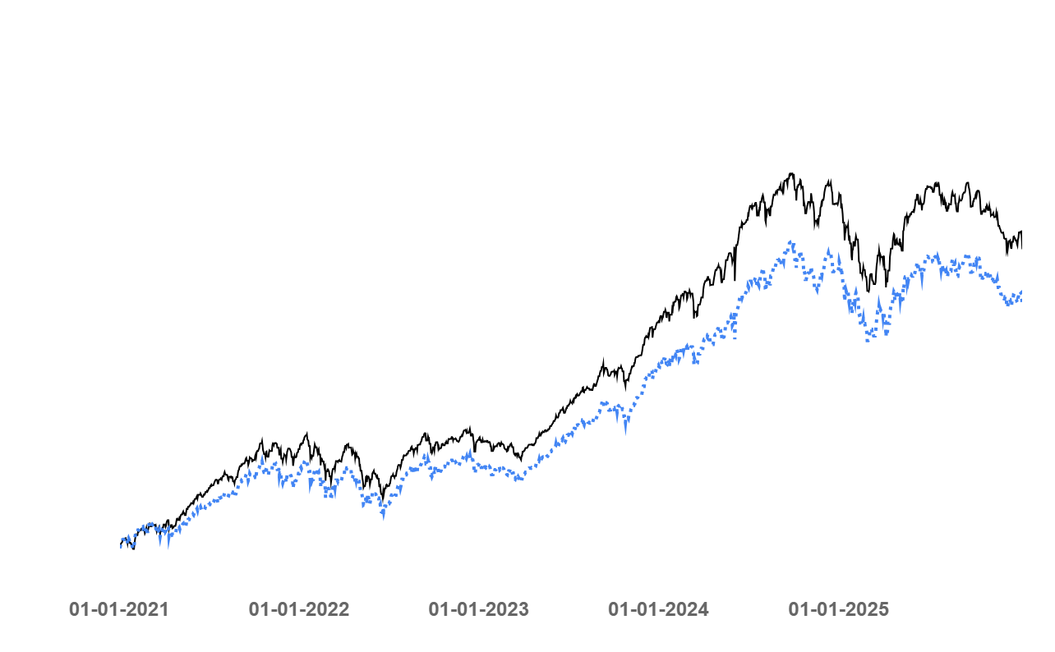
Your portfolio with Infinite’s approach of smarter allocation, data-backed selection and tax efficient rebalancing
Actual Gains
Infinite Very Aggressive
Comparison of portfolio gains with Infinite and Actual
 | With Infinite | Actual
Annualized Returns* | 20.16% | 17.69%
49.7L
41.5L
*XIRR since 1st Jan 2021

Slide 14
04
Your portfolio construction

Slide 15
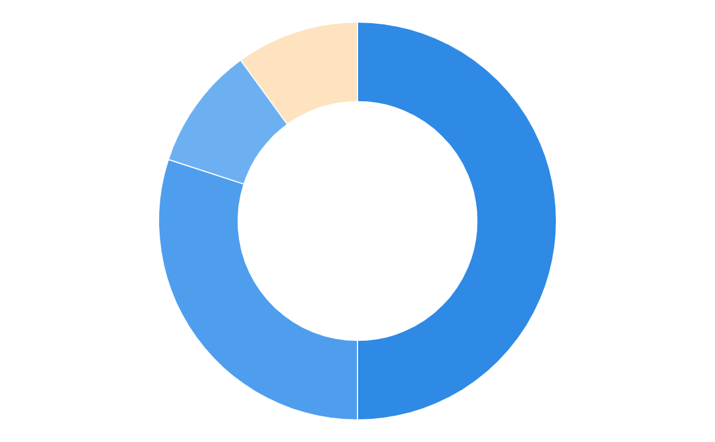
Recommended Portfolio
Infinite Very AggressiveLumpsum
A high-conviction, growth-oriented portfolio designed to maximise long-term wealth creation
Equity
90%
Aggressive
50%
Portfolio
Allocation
Balanced
30%
Retirement Planning
Conservative
10%
Goal Coverage
Hybrid
10%
Notes:
Infinite Ascend (Very Aggressive)
Infinite Propel (Aggressive)
Infinite Core (Balanced)
Infinite Secure (Conservative)
Infinite Anchor (Very Conservative)

Slide 16
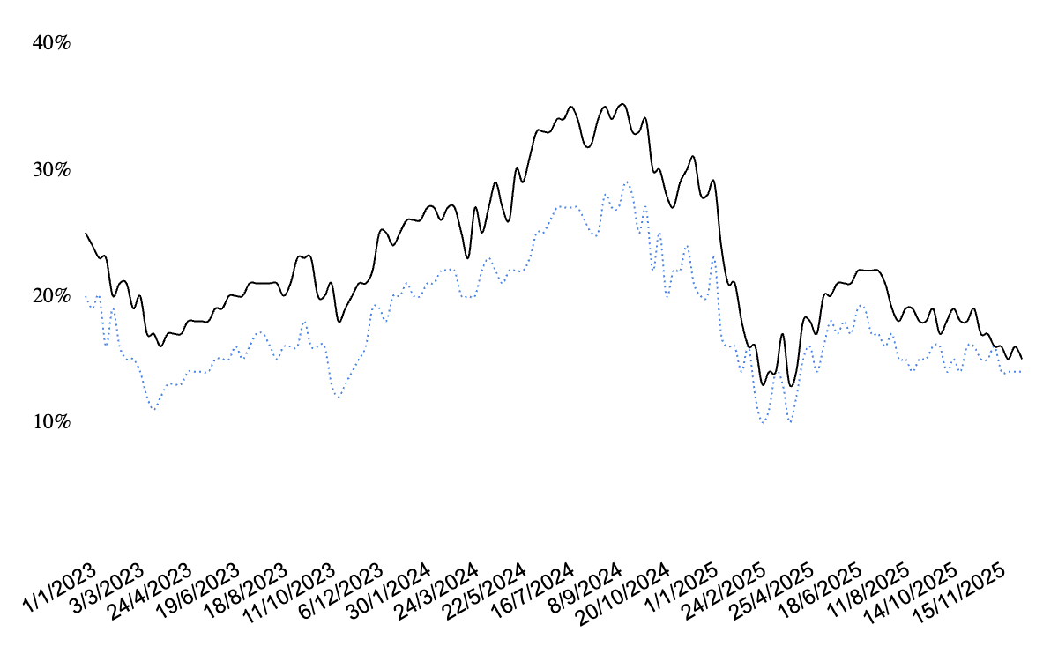
Performance of our recommended portfolio (Infinite Very Aggressive L)
Benchmark (Nifty 500)
Infinite - VA L
3Y XIRR trend
Last 1Y Avg | Infinite VA L | Benchmark (Nifty 500) | Alpha
3Y XIRR | 18.57% | 15.38% | 3.19%
5Y XIRR | 20.72% | 16.69% | 4.03%
7Y XIRR | 21.14% | 17.10% | 4.04%
Downside Capture | 98.69 | 100.0
Trailing Return*** (as on 1st Jan 2026) | 1M | 3M | 6M | 1Y | 2Y | 3Y | Since 2021
Infinite VA L | -0.82% | 2.18% | 0.33% | 1.87% | 13.30% | 20.03% | 21.20%
Benchmark (Nifty 500) | -0.05% | 4.41% | 1.71% | 7.42% | 11.87% | 16.57% | 16.78%
Alpha | -0.77% | -2.23% | -1.38% | -5.55% | 1.43% | 3.46% | 4.42%
**Downside Capture = (Fund return during down markets ÷ Benchmark return during down markets) × 100 | *** 1M 3M and 6M returns are absolute, while 1Y 2Y 3Y and Since 2021 are annualized | Past performance may not be indicative of future results; returns are subject to market risks.

Slide 17
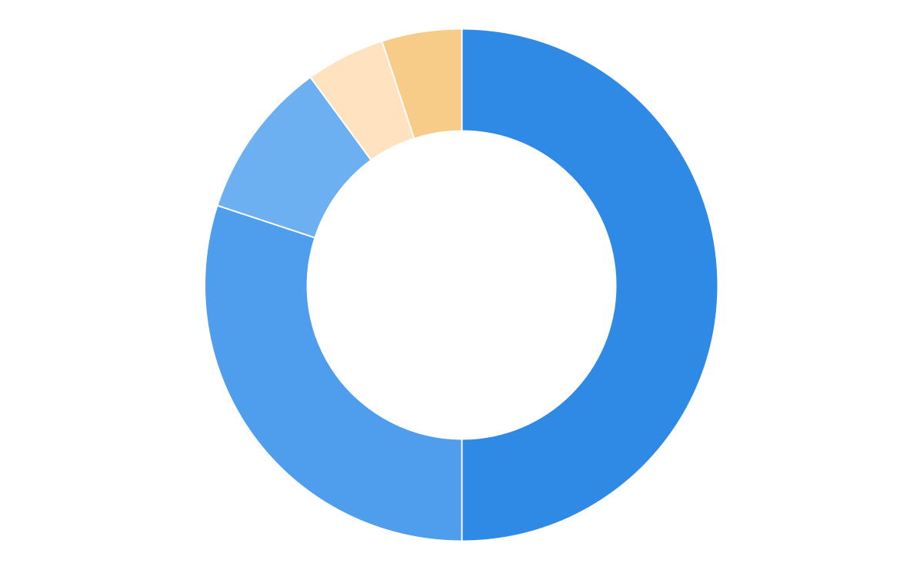
Recommended Portfolio
Infinite Very AggressiveSIP
A high-conviction, growth-oriented portfolio designed to maximise long-term wealth creation
Equity
90%
Aggressive
50%
Portfolio
Allocation
Balanced
30%
Retirement Planning
Conservative
10%
Goal Coverage
Hybrid
5%
Gold
5%
Notes:
Infinite Ascend (Very Aggressive)
Infinite Propel (Aggressive)
Infinite Core (Balanced)
Infinite Secure (Conservative)
Infinite Anchor (Very Conservative)

Slide 18
Performance of our recommended portfolio (Infinite Very Aggressive S)
Benchmark (Nifty 500)
Infinite - VA S
3Y XIRR trend
Last 1Y Avg | Infinite VA S | Benchmark (Nifty 500) | Alpha
3Y XIRR | 18.80% | 15.38% | 3.42%
5Y XIRR | 20.78% | 16.69% | 4.09%
7Y XIRR | 21.15% | 17.10% | 4.05%
Downside Capture | 96.97 | 100.0
Trailing Return*** (as on 1st Jan 2026) | 1M | 3M | 6M | 1Y | 2Y | 3Y | Since 2021
Infinite VA S | -0.76% | 2.33% | 0.77% | 2.52% | 13.71% | 20.33% | 21.22%
Benchmark (Nifty 500) | -0.05% | 4.41% | 1.71% | 7.42% | 11.87% | 16.57% | 16.78%
Alpha | -0.71% | -2.08% | -0.94% | -4.90% | 1.84% | 3.76% | 4.44%
**Downside Capture = (Fund return during down markets ÷ Benchmark return during down markets) × 100 | *** 1M 3M and 6M returns are absolute, while 1Y 2Y 3Y and Since 2021 are annualized | Past performance may not be indicative of future results; returns are subject to market risks.

Slide 19
05
Financial
Planning

Slide 20
Our investment plans ensure you are life ready always!
With Infinite Very Aggressive (modelled at 15%)- By gliding balances from your main corpus towards your life goals in a phased manner
Year
Amount
Financial Freedom
2033
₹3.04 Cr
Assumptions: Infinite PF Value: INR 1 Cr and SIP of INR 25K, Current monthly expenses: 1L (+10% after retirement)
Notes:
If 175000 SIP is managed by us

Slide 21
Whats Next?
On finalization of your portfolio strategy, we will move ahead with
PowerUp Infinite Agreement Signing & Onboarding Fee Payment
Portfolio Transition Plan (Fully Tax Optimised)
Portfolio Execution

Slide 22
06
Appendix

Slide 23






Equity
Flexi Cap
Power Rating
Current Value (% of Portfolio)
XIRR
Your | Benchmark
Missed Gains
SBI Flexicap Direct Growth
17.4L (18.4%)
21.3% | 23.3%
-
HDFC Flexi Cap Direct Growth
5.0L (5.3%)
6.7% | 1.5%
-
Parag Parikh Flexi Cap Fund Direct Growth
4.7L (5.0%)
12.5% | 12.5%
-
JioBlackRock Flexi Cap Fund Direct Growth
-
25K (0.3%)
4.7% | 0.4%
-
Go back
In-form
On-track
Off-track
Out-of-form

Slide 24

Equity
Mid Cap
Power Rating
Current Value (% of Portfolio)
XIRR
Your | Benchmark
Missed Gains
Sundaram Mid Cap Regular Growth
21.5L (22.7%)
16.4% | 19.1%
1.5L
Motilal Oswal Midcap Direct Growth
5.7L (6.0%)
-30.1% | 2.4%
-
Sundaram Mid Cap Direct Growth
2.4L (2.6%)
26.0% | 26.4%
-
Go back
In-form
On-track
Off-track
Out-of-form

Slide 25
Equity
Small Cap
Power Rating
Current Value (% of Portfolio)
XIRR
Your | Benchmark
Missed Gains
Bandhan Small Cap Fund Direct Growth
6.4L (6.7%)
-5.8% | -13.6%
-
HSBC Small Cap Fund Regular Growth
4.9L (5.2%)
19.1% | 19.0%
60K
Go back
In-form
On-track
Off-track
Out-of-form

Slide 26
Equity
Large Cap
Power Rating
Current Value (% of Portfolio)
XIRR
Your | Benchmark
Missed Gains
ICICI Prudential Large Cap Fund Regular Growth
5.7L (6.0%)
16.9% | 14.8%
20K
Go back
In-form
On-track
Off-track
Out-of-form

Slide 27
Infinite Questionnaire (1/6)
What is your age?
46–55
What is your current employment status?
Actively working
Engaged in a full-time or part-time job, business, or self-employed with regular active income.
What is your primary source of income?
Active income only
Regular earnings from salary, freelancing, or business.
Go back

Slide 28
Infinite Questionnaire (2/6)
What is your reason for investing in mutual funds?
Retirement Planning
What types of liabilities do you have?
Dependent liabilities only
People depend on your income, no loans.
Can you comfortably meet your liabilities (as answered in the above question) from your current income?
Yes - comfortably
I have enough surplus, no stress.
Go back

Slide 29
Infinite Questionnaire (3/6)
How many months of emergency fund do you currently have saved?
Upto 6 months
How do you prefer your mutual fund portfolio to grow?
Grow faster, even if it means high risk.
High risk
Average returns: 15% p.a.
Worst & best case: -10% to +25%
What is your investment horizon?
Long-term wealth creation
More than 8 years
Go back

Slide 30
Infinite Questionnaire (4/6)
If your investments fall by 20% within a few months, what would you do?
Invest more
I will average my cost
Lumpsum Investment Amount (your existing mutual funds and / or cash)
INR 1 Cr
Monthly SIP Amount
INR 25K
Go back

Slide 31
Infinite Questionnaire | Goals (5/6)
Current monthly income & monthly expense
Income: INR 2.5L ; Expenses: INR 1L
Expected change in expenses post-retirement (-40% to +40%)
10%
Current monthly investment
-
Go back

Slide 32
Infinite Questionnaire | Goals (6/6)
Expected year-on-year increase in investment
10%
Value of financial investments apart from mutual funds (e.g., FD, stocks, PMS, etc.)
INR 15L
Liabilities (EMI / Loans)
None
Go back

Slide 33
Infinite Questionnaire | Home Purchase (7/10)
When do you want to purchase it?
2035
Flexibility to shift your purchase timeline by the number of years?
5 years
Estimated value of home (in today’s value)
INR 2,00,00,000
Go back

Slide 34
Infinite Questionnaire | Home Purchase (8/10)
Would you be open to opting for debt financing (Home loan)?
Yes
Estimated down payment if opted "Yes" for debt financing?
40%
Current monthly rent
None
Go back

Slide 35
Infinite Questionnaire | Children's Education (9/10)
Number of children whose education you want to plan for?
1
Expected start year of your child’s undergraduate education
2037
Estimated cost for undergraduate education (in today’s value)
INR 12,00,000 for each of them
Go back

Slide 36
Infinite Questionnaire | Children's Education (10/10)
Expected start year of your child’s postgraduate education
2039
Estimated cost of postgraduate education (in today’s value)
INR 1,20,00,000
Go back

Slide 37
Infinite Questionnaire | Children’s Marriage (11/11)
Number of children whose marriage you want to plan for?
1 - Manya
What is the expected timeframe for the marriage?
2032 (7 years from now)
Estimated budget for marriage (in today’s value)
INR 1.5 Cr
Go back

Slide 38
Infinite Questionnaire | Vehicle Purchase (7/8)
When do you want to purchase it?
2027
Flexibility to shift your purchase timeline by the number of years?
Yes, open ended
Estimated value of vehicle (in today’s value)
INR 40L
Go back

Slide 39
Infinite Questionnaire | Vehicle Purchase (8/8)
Would you be open to opting for debt financing (Vehicle loan)?
Yes
Estimated down payment if opted "Yes" for debt financing?
20%
Go back

